Slide 1

WORK / ENERGY
Adopted from MIT Course
FISIKA DASAR 1

Slide 2

Work Done by a Force
Not a vector quantity (but vector concepts needed to calculate its value)
Depends on both the direction of the force and the direction of the motion
Four ways of saying the same thing
force times component of motion along the force
distance times the component of force along the motion
Adopted from MIT Course

Slide 3
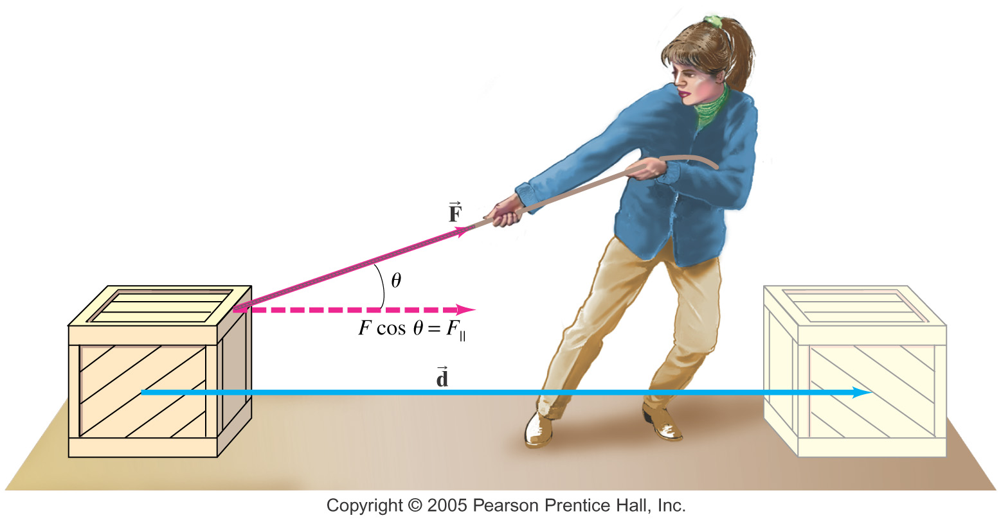
c) W = ∑F d cos⍬, where “⍬” is the angle between F and d
d) W = ∫F . ds, where the “s” vector is along the path
The work done by a constant force is defined as the distance moved multiplied by the component of the force in the direction of displacement:
Adopted from MIT Course

Slide 4
Work/Energy Concepts
Energy is never created or destroyed, only moved from one form to another or one object to another
Work is change in energy
In this course, energy will always consist of two components, Kinetic Energy (KE) and Potential Energy (PE)
Adopted from MIT Course

Slide 5
Kinetic Energy
Energy is the ability to do work
Kinetic Energy is energy due to motion
For an object moving with a speed of v
KE = ½ m v²
Work of net external force = change in kinetic energy
W = ∆KE = KE_{final} – KE_{initial}
Adopted from MIT Course

Slide 6
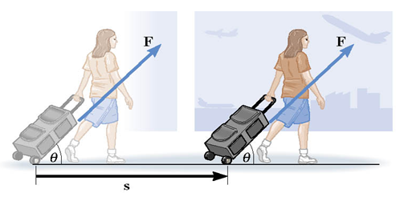
Example 1
e
Dian pulls a backpack on wheels down the 100 m hall. The 60 N force is applied at an angle of 60° above the horizontal. How much work is done by Dian?
Solution
W = F d cosθ
W = (60 N) (100 m) cos(60º)
W = 3.10³ J

Slide 7

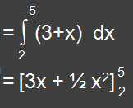
Example 2
e
A force F = (3+x) acts on a particle in x direction. Where F is in newton and x in metre. Find the work done by this force during a displacement from x₁ = 2 m to x₂ = 5 m.
Solution
= [3.5 + ½.5²] - [3.2 + ½.2²]
= 19,5 J

Slide 8
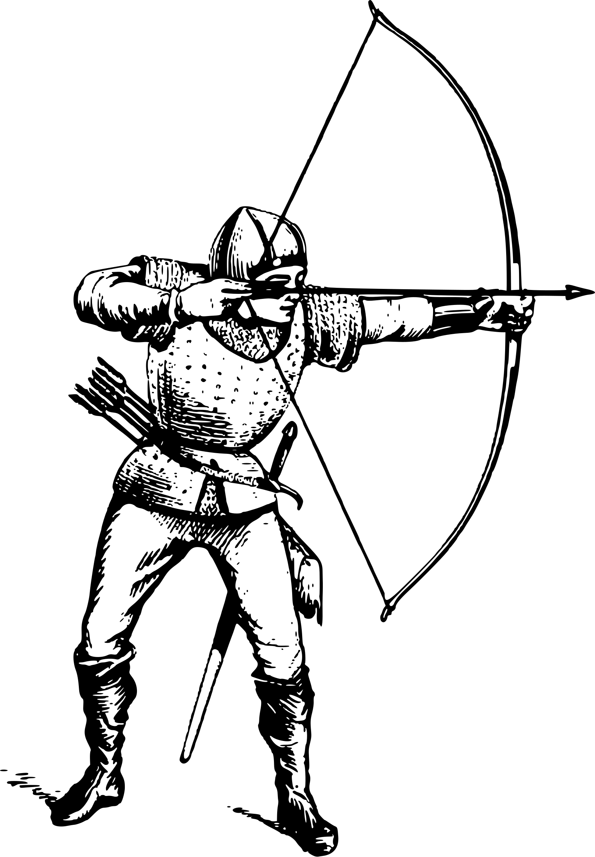
Example 3
e
A 0.075 kg arrow is fired horizontally. The bowstring exerts a force on the arrow over a distance of 1.2 m. The arrow leaves the bow at 40 m/s. What average force does the bow apply to arrow?
Solution
W = KE_{f} − KE_{i}
= ½ (0.075 𝑘𝑔) (40 𝑚/𝑠)² − ½ (0.075 𝑘𝑔) (0 𝑚/𝑠)²
= 60 J
W = F d
60 J = F (1.2 𝑚)
F = 50 N

